Slide 1
RNA-seq Quality Control
Before the analysis begins

Slide 2
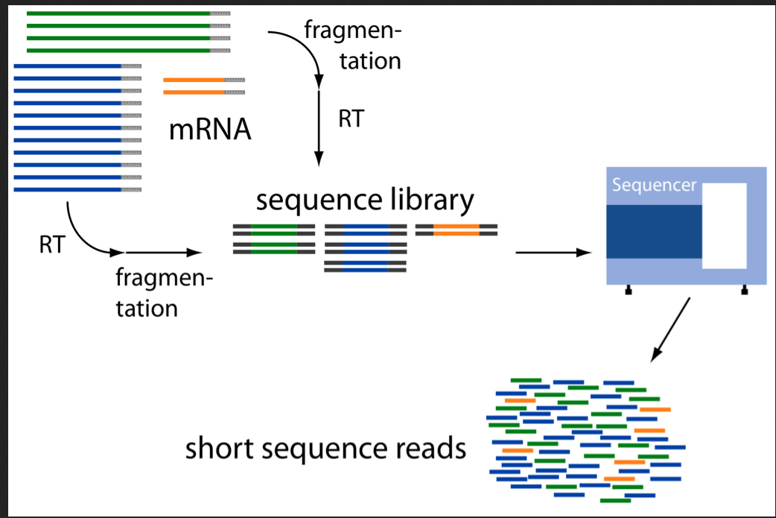
RNA-seq libraries
What could go wrong?

Slide 3
What could go wrong?
RNA quality:
Degradation
Contaminations (pathogens or other sources)
GC-bias
Nuclear vs organelle reads
Library prep:
Failed reactions
RNA / Adapter ratios – primer dimers
Clonal duplicates
Chimeric reads
Contaminations
Sequencing:
Base calling errors
Uncalled bases
Low quality bases (3’ end)
Contaminations
Sequence complexity

Slide 4
From samples to reads - may not be what you think they are
Mixing samples
Experiments go wrong
How do we understand what went wrong?

Slide 5
Read QC
- FastQC
Mapping statistics
Mapping QC
- RseQC
reads.fastq.gz
STAR
mappedReads.bam
Reads
Mapping
Mapped reads
Gene annotation:
ref.bed / ref.gtf
Reference
genome.fa
Gene expression
Outlier detection, sample swaps

Slide 6
Fastq – read file format
Unique identifier
Sequence
@SEQ_ID
GATTTGGGGTTCAAAGCAGTATCGATCAAATAGTAAATCCATTTGTTCAACTCACAGTTT
+
!''*((((***+))%%%++)(%%%%).1***-+*''))**55CCF>>>>>>CCCCCCC65
Sequence quality
Paired end data usually in format sampleX_1.fastq and sampleX_2.fastq with same SEQ_ID for both mate pairs, followed by
/1 and /2 (or _f and _r)

Slide 7
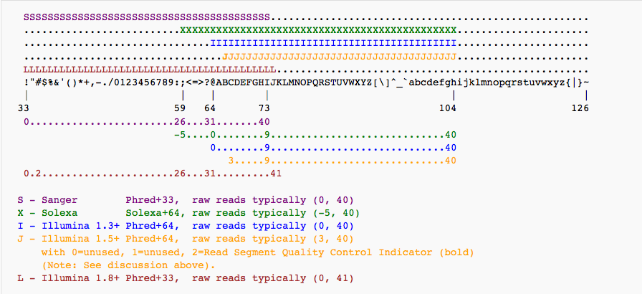
Fastq – read file format
@SEQ_ID
GATTTGGGGTTCAAAGCAGTATCGATCAAATAGTAAATCCATTTGTTCAACTCACAGTTT
+
!''*((((***+))%%%++)(%%%%).1***-+*''))**55CCF>>>>>>CCCCCCC65

Slide 8
Read QC
- FastQC
reads.fastq.gz
STAR
mappedReads.bam
Reads
Mapping
Mapped reads
Gene annotation:
ref.bed / ref.gtf
Reference
genome.fa
Gene expression

Slide 9
Basic read metrics with FastQC
A program that analyses some of the basic metrics on fastq raw read files.
Quality
Length
Sequence bias
GC content
Repeated sequences
Adapter contamination
http://www.bioinformatics.babraham.ac.uk/projects/fastqc/

Slide 10
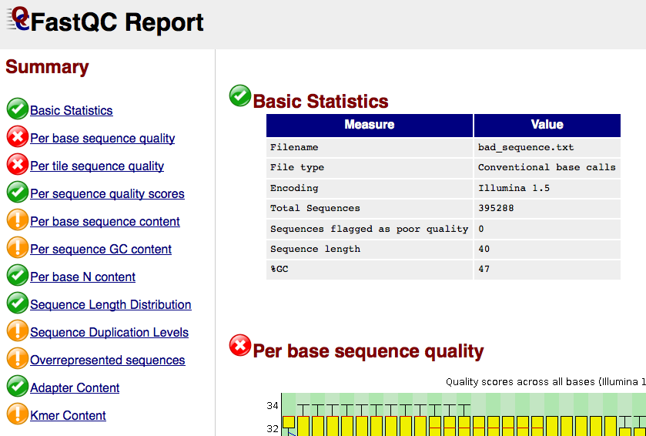
FastQC report

Slide 11
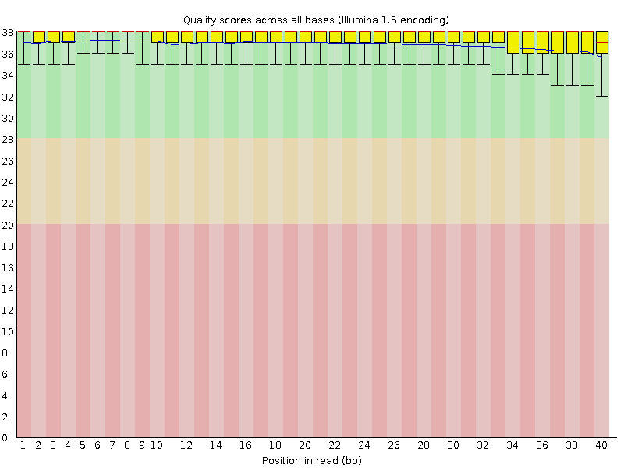
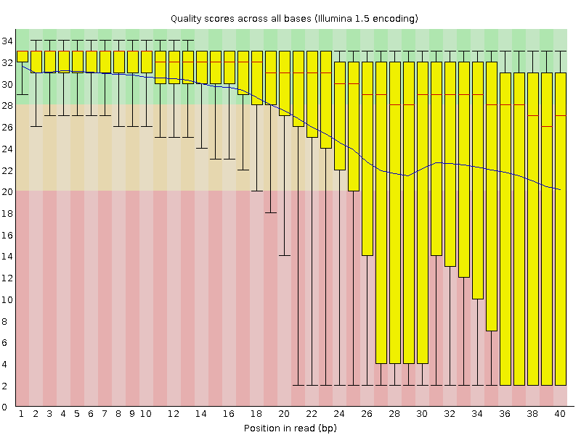
Per base sequence quality

Slide 12
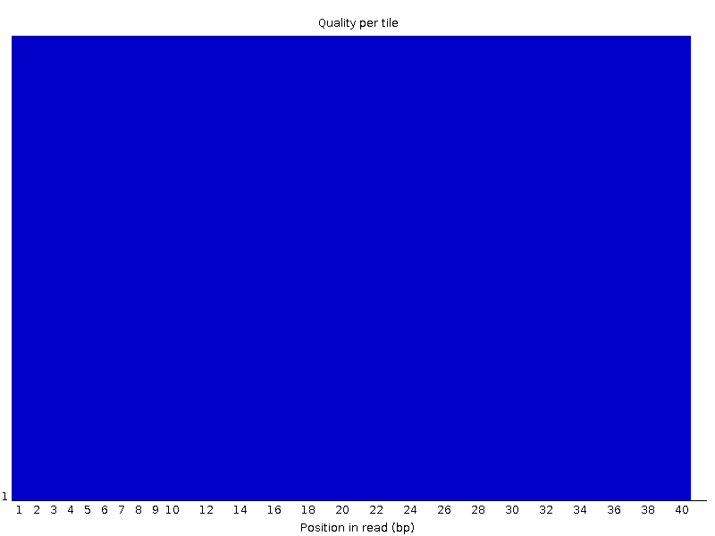
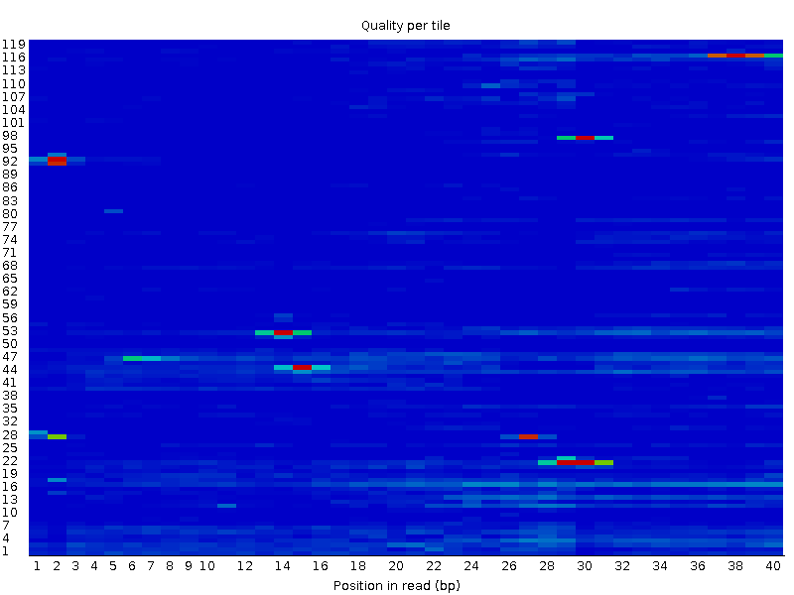
Per tile sequence quality (Illumina)

Slide 13
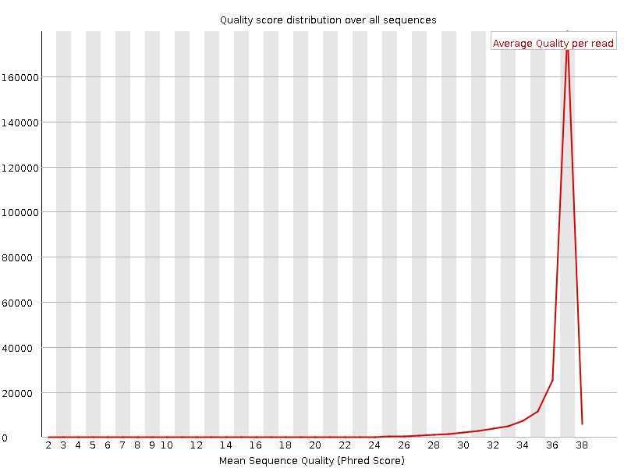
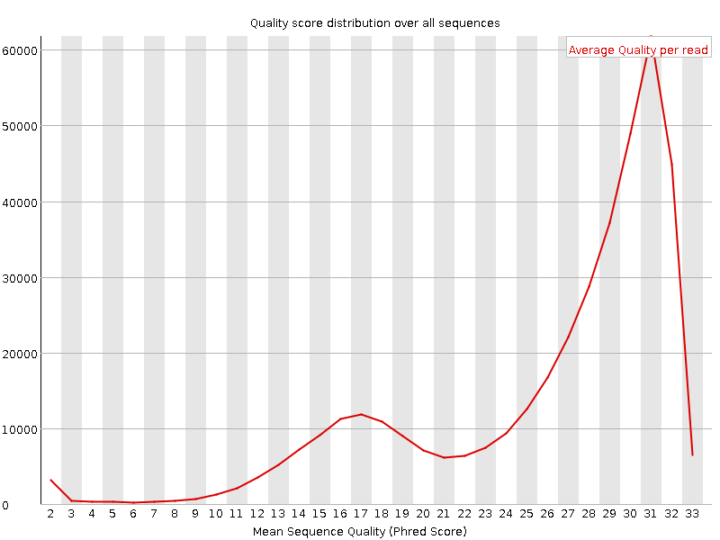
Per sequence quality scores

Slide 14
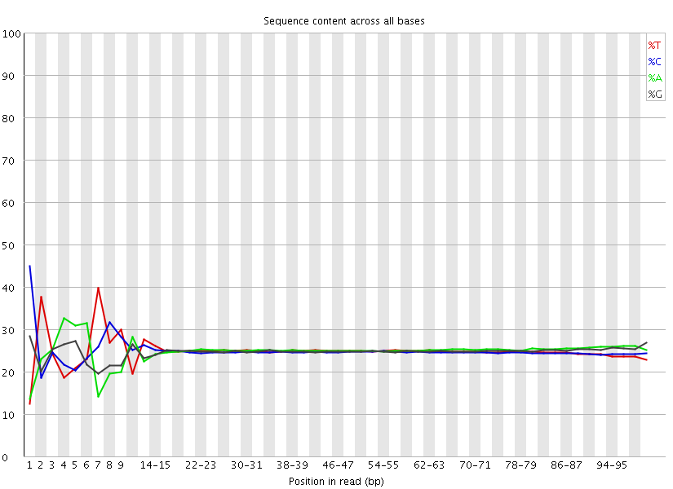
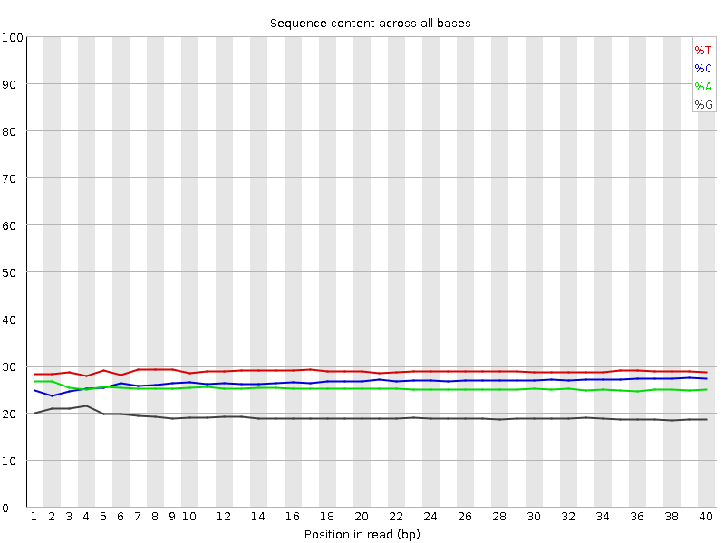
Per base sequence content

Slide 15
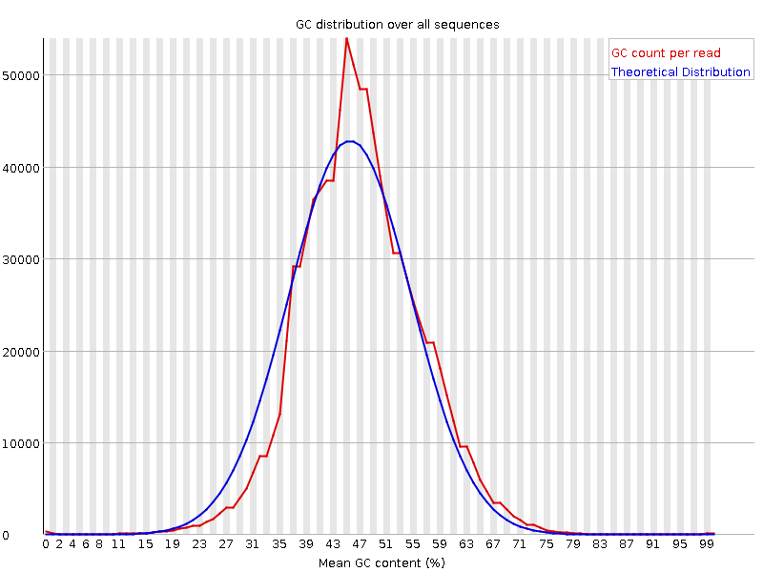
Per sequence GC content

Slide 16
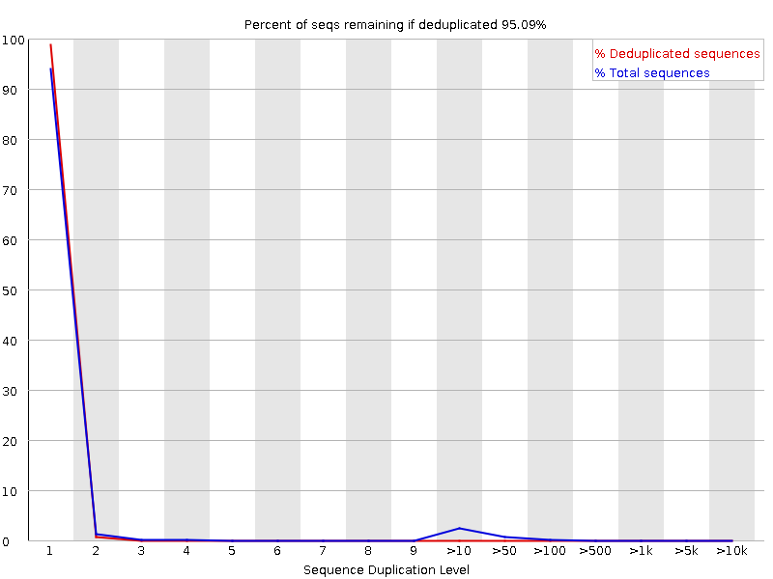
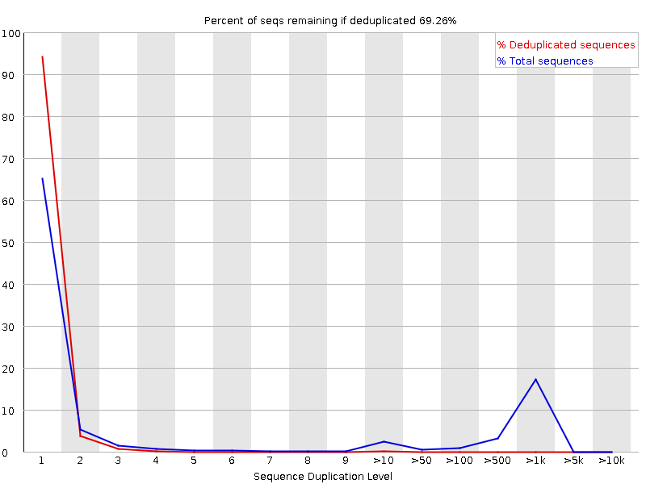
Sequence Duplication Levels

Slide 17
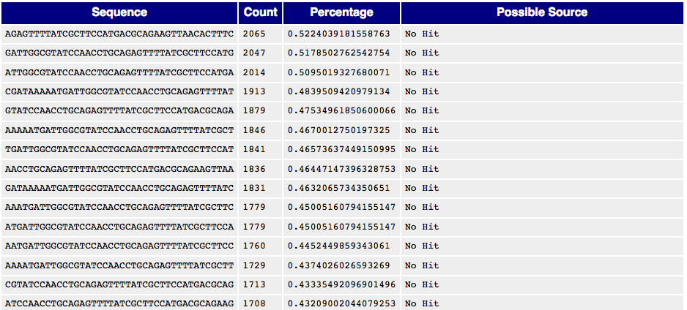
Overrepresented sequences

Slide 18
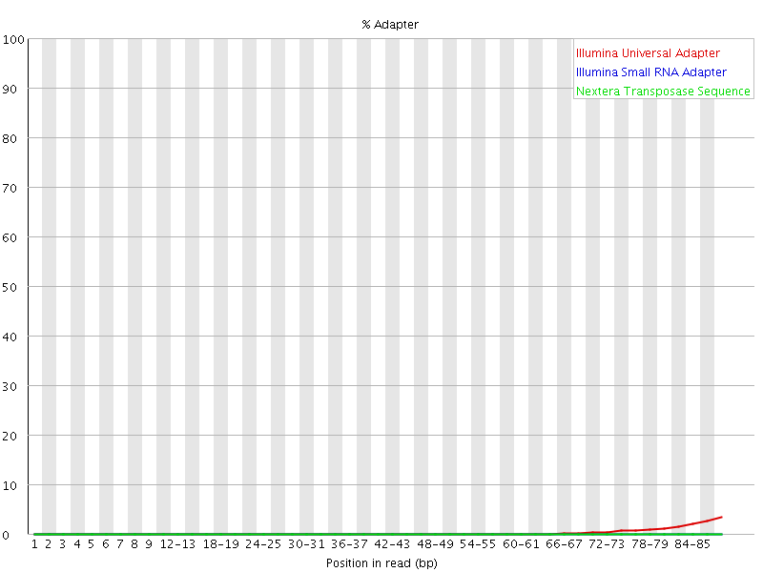
Adapter Content

Slide 19
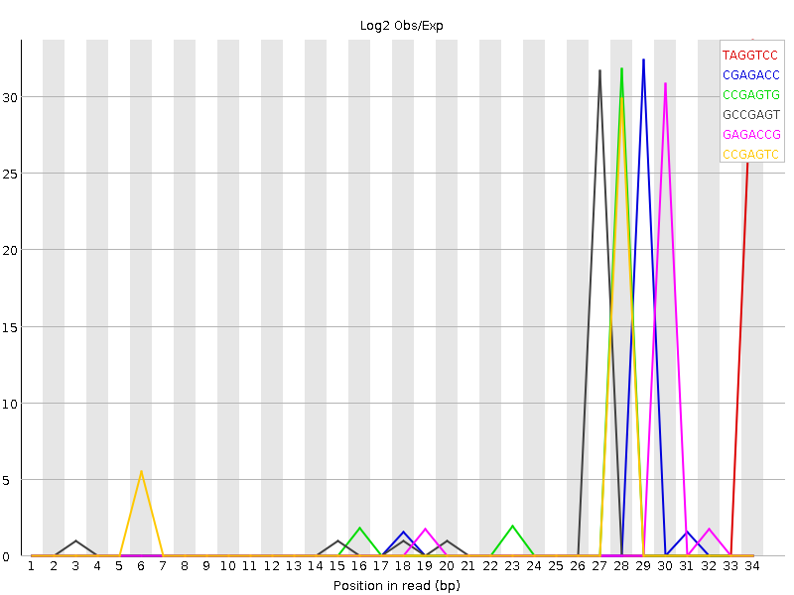
Kmer content

Slide 20
Failed FastQC – what to do?
Try to figure out why
If problem seem to be related to problems during sequencing – resequence!
If problem is related to library prep – rerun if possible.
You can filter out the low quality reads
Adapter trimming (cutadapt)
Filter low phred score reads (samtools, jaccard)
If you have enough reads after filtering the data may still be useful.
But be careful to do equal trimming on all samples!

Slide 21
Mapping statistics
reads.fastq.gz
STAR
mappedReads.bam
Reads
Mapping
Mapped reads
Gene annotation:
ref.bed / ref.gtf
Reference
genome.fa
Gene expression

Slide 22
Mapping logs – mapping efficiency
Program specific how the output will be (STAR, Bowtie, BWA, Tophat…)
Always gives:
% uniquely mapping – ideally around 90% for 100 bp reads
% multi-mapping – will depend on read length
% unmapped – could indicate contaminations, adaptors
Also statistics on:
Mismatches / indels
Splice junctions

Slide 23
Bad mapping – what to do?
First step – try to figure out why it failed. With the use of FastQC/RseQC/Mapping logs.
Perhaps also look for contaminant species
Redo library prep controlling for possible errors
Low mapping, but not completely failed.
Figure out why!
Is it equal for all samples?
Could it introduce any bias in the data?

Slide 24
Mapping QC
- RseQC
reads.fastq.gz
STAR
mappedReads.bam
Reads
Mapping
Mapped reads
Gene annotation:
ref.bed / ref.gtf
Reference
genome.fa
Gene expression

Slide 25
SAM/BAM file formats
All mapped reads with location in genome, mapping information etc.
SAM (Sequence Alignment/Map) format – alignment.sam
BAM is a compressed sam format – alignment.bam
A bam-file (always) needs to be indexed and sorted - alignment.bam.bai
Samtools – a simple program for converting between bam/sam, indexing, sorting, filtering, etc.

Slide 26
SAM/BAM file format
HWI-ST1018:7:1101:1648:2188#0 99 chr1 115275270 255 1S100M = 115275321 152 NTTCTATATTGGTTGCTCGCTCTAATTTGTCACGTCGGTCTGTTGAAATATTAAACCTAACATGGTCACCTTCCAGCAGGGTCACCTTGGATTTCGTATCT BS\cceeeggeggghhhhbghhhhhhhhhhfhhhhhhhfhhhhhhhffhhhffhhhfffgghhgg\Z^ddeeeedbdbdcacbabcbcccbbbcc^abbc] NH:i:1 HI:i:1 AS:i:194 nM:i:0
HWI-ST1018:7:1101:1648:2188#0 147 chr1 115275321 255 101M = 115275270 -152 AAACCTAACATGGTCACCTTCCAGCAGGGTCACCTTGGATTTCGTATCTTTGTCTCCAAAGGGAAGTTCTTTAGGGATCACAAAGTCNANTTTGNTNNGTC BBccbdccccccccbbcccccddcddeeeeccggggghihiiiiifhihfgiiihhhhihhihiiiihhiihiiiiihihhihgd]RBRBec]QBQBBbbb NH:i:1 HI:i:1 AS:i:194 nM:i:0
HWI-ST1018:7:1101:2039:2206#0 99 chr19 14574483 255 1S72M85N28M = 14574529 232 NCCTTCCGCAACCCTGTCATTGAGAGGATTCCTCGGCTCCGACGGCAGAAGAAAATTTTCTCCAAGCAGCAAGGGAAGGCGTTCCAGCGTGCTAGGCAGAT BP\cceeefgggghhighiiiiiiiiihhhiiiiihiiiiiiihiggeeedddddbbbcccbbccb^[`aaccccccccccX]accccc^acc]bc^b_a] NH:i:1 HI:i:1 AS:i:203 nM:i:0 XS:A:+
HWI-ST1018:7:1101:2039:2206#0 147 chr19 14574529 255 26M85N75M = 14574483 -232 GAAGAAAATTTTCTCCAAGCAGCAAGGGAAGGCGTTCCAGCGTGCTAGGCAGATGAACATCGATGTCGCCACGTGGGTGCGGCTGCTCCGGAGGCTCATCC ]ccdcccbbbacbcaccccbcccccccccccbcccaccccccccdd_dddeeeeeeeggggiiiiihihiiiiiiiihiihiiiiiiigfgggeeeeebbb NH:i:1 HI:i:1 AS:i:203 nM:i:0 XS:A:+
More details on:
http://samtools.github.io/hts-specs/SAMv1.pdf
http://genome.sph.umich.edu/wiki/SAM

Slide 27
After mapping - RseQC package
General sequence QC:
sequence quality
nucleotide composition bias
PCR bias and
GC bias
RNA-seq specific QC:
evaluate sequencing saturation
mapped reads distribution
coverage uniformity
strand specificity
Etc..
Some tools for file manipulations
http://rseqc.sourceforge.net/

Slide 28
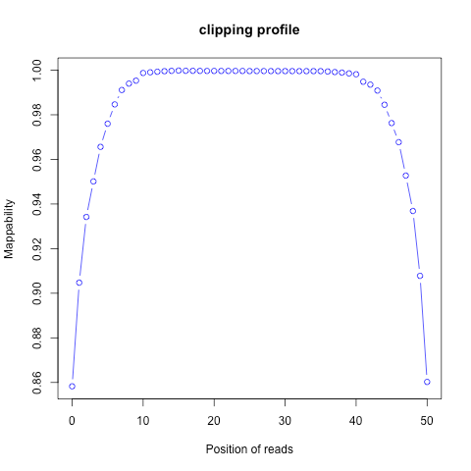
Soft clipping - clipping_profile.py

Slide 29
Gene coverage - geneBody_coverage.py
Not degraded
Degraded

Slide 30
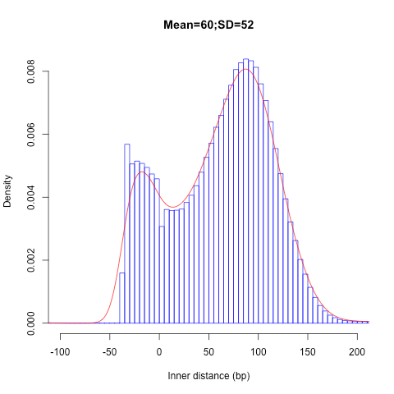
Distance between PE-reads - inner_distance.py

Slide 31
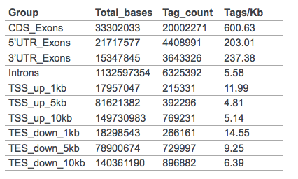
Where in the genome do your reads map? - read_distribution.py

Slide 32
Bad RseQC output – what to do?
Try to figure out what went wrong.
Redo library prep controlling for possible errors
Is it equal for all samples?
Could it introduce any bias in the data?
RNA-degradation in some samples
Possible to use a region at 3’ end for expression estimates.

Slide 33
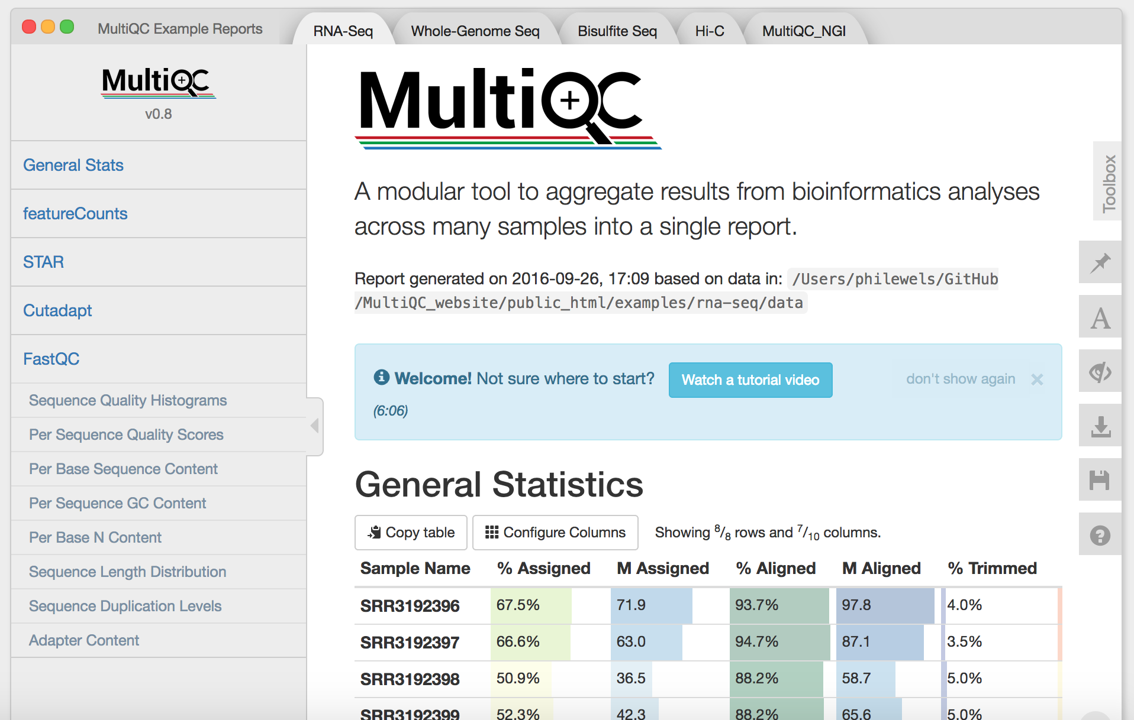
MultiQC – summary of QC stats
Code
$ module load bioinfo-tools
$ module load MultiQC
$ multiqc .
( http://multiqc.info/ )

Slide 34
reads.fastq.gz
STAR
mappedReads.bam
Reads
Mapping
Mapped reads
Gene annotation:
ref.bed / ref.gtf
Reference
genome.fa
Gene expression
Outlier detection, sample swaps

Slide 35
Sample swaps and outliers can be identified using PCA
Reads
Mapping
Mapped reads
Reads
Mapping
Mapped reads
Reads
Mapping
Mapped reads
Reference
Expression
per gene
Table with counts, rpkms, fpkms or similar
Reference
Expression
per gene
Reference
Expression
per gene
Reads
Mapping
Mapped reads
Reads
Mapping
Mapped reads
Reads
Mapping
Mapped reads
Reads
Mapping
Mapped reads
Reference
Expression
per gene
Reference
Expression
per gene
Reference
Expression
per gene
Reference
Expression
per gene

Slide 36
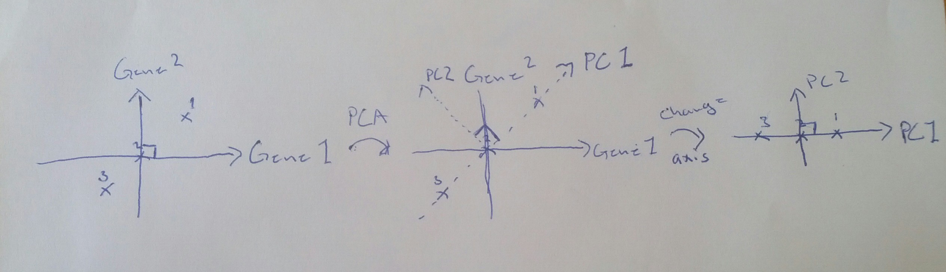
Differences in read distribution between samples can be identified using Principal Component Analysis (PCA)

Slide 37
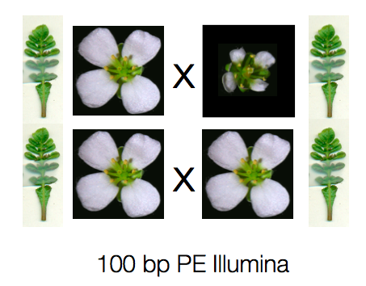
QC test case 1
Samples from three different species
C.rubella
Small flowers
Normal leaves
Genome is sequenced
C. grandiflora
Large flowers
Normal leaves
Hybrid
Intermediate flowers
Normal leaves

Slide 38
Principal component 1 separates samples from flowers and leaves
C. rubella

Slide 39
Principal component 2 and 3 separates the different species
C. rubella
C. rubella
hybrid
C. grandiflora

Slide 40

QC test case 2
4 Tissues
Fat body
Gut
Labial gland
Malphighian tubules
3 Phylogenetic groups
>70 samples

Slide 41
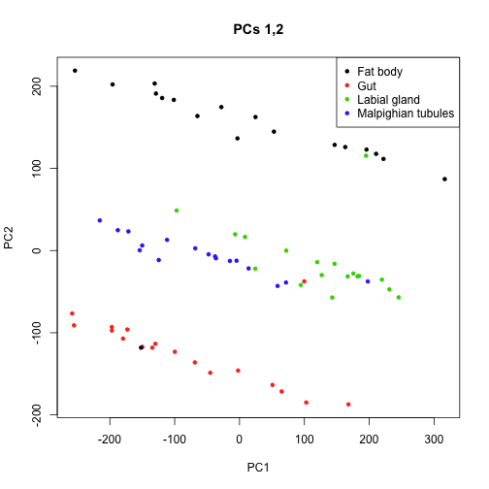
PCA analysis detected potential sample swaps

Slide 42
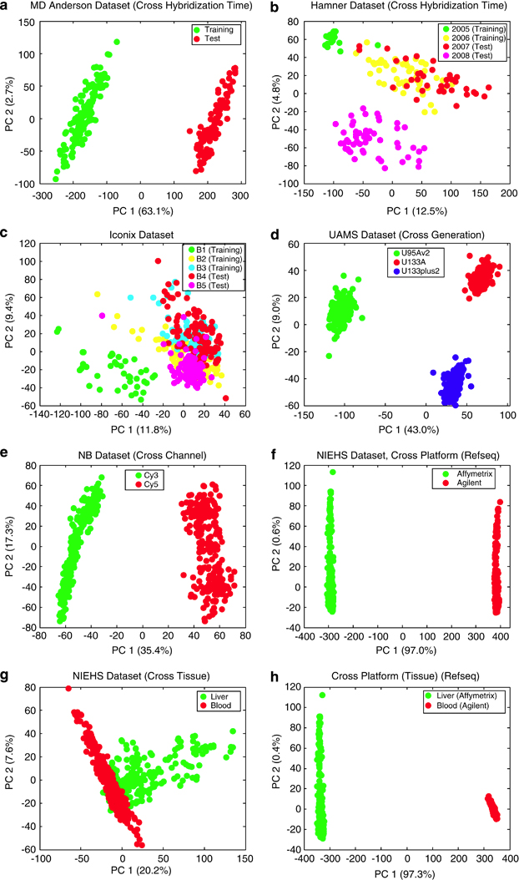
QC test case 3
PCA detects clear batch effect
(Luo et al. Pharmacogen. J. 2010)

Slide 43
My PCA looks strange – what to do?
Clear sample swaps
Check sequence indices, lab logs etc. to verify new classification.
If you have enough replicates, remove instead of changing labels if you are uncertain.
Clear batch effects
Can use batch normalization to remove the effect
Outliers
Figure out why they are outliers
Do not remove samples only because they do not fit your expectation – Bad science!
PCA does not group my sample sets
Try different methods of dimensionality reduction / clustering
Perhaps technical/biological variation is higher than your expected effect -> Batch normalization

Slide 44
Sources of variation
Biological variation
Patient to patient variation
Sex
Time points of samples taken
Etc…..
Technical variation
At each step of RNA extraction and library preparation

Slide 45
Spike-in control RNA
Addition of external RNA molecules into the samples before library prep
Will give estimate of technical variation:
Sensitivity / detection
Accuracy
Specific biases
Also used to estimate amount of RNA in the samples
Most commonly ERCC - pool of 48 or 96 synthetic mRNAs with various lengths and GC content, at 17 different concentrations
Allows for cross comparison of datasets

Slide 46
Replicates, replicates, replicates
Technical replicates
Biological replicates
If you have enough material, always do extra replicates in case you want to remove low quality samples.

Slide 47
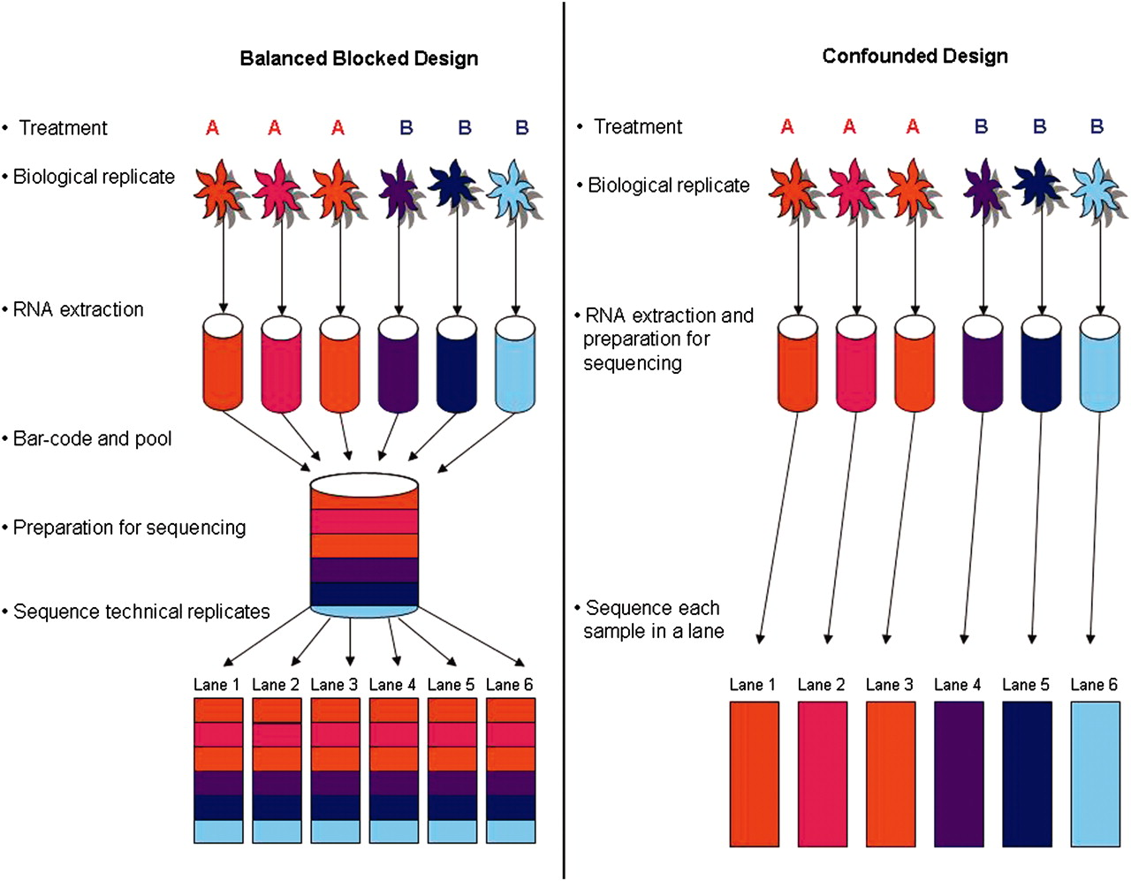
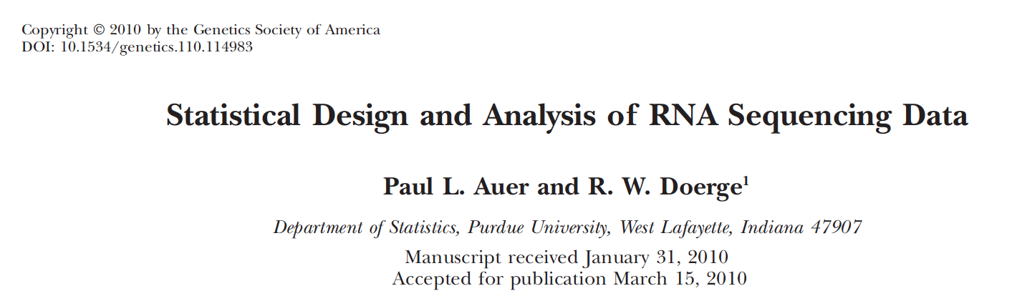
Experimental Design

Slide 48
Conclusions
Good quality data is the first step in any RNA-seq experiment
The reason for low quality samples may require some detective work
More replicates allows you to filter out low quality libraries without losing statistical power
Depending on where you sequence, some of the QC steps will be performed at the platform.

